Slide 1

Digital Wallet at American Express – Behind the Scenes
Santhar Sengodan
Technical Project Manager
Network API Platform (Aka Digital Network) - GNT
VP Delivery & Integrator : Alan Holmes

Slide 2
Pre requisite
Short movie (3 mins):
Apple Pay Provision:
https://bluetube.aexp.com/i/playvideo/?id=5535805ee4b096d93bb15fd9
Apple Pay NFC Payment:
https://bluetube.aexp.com/i/playvideo/?id=556bd375e4b085057886d0f6

Slide 3
contents
Apple Pay : Link and Provision
Add Card | 6
Provision | 9
Tenured channel | 11
OTP | 13
Activate and Ready for Apple Pay! | 15
Apple Pay NFC Authorization and Settlement | 16

Slide 4
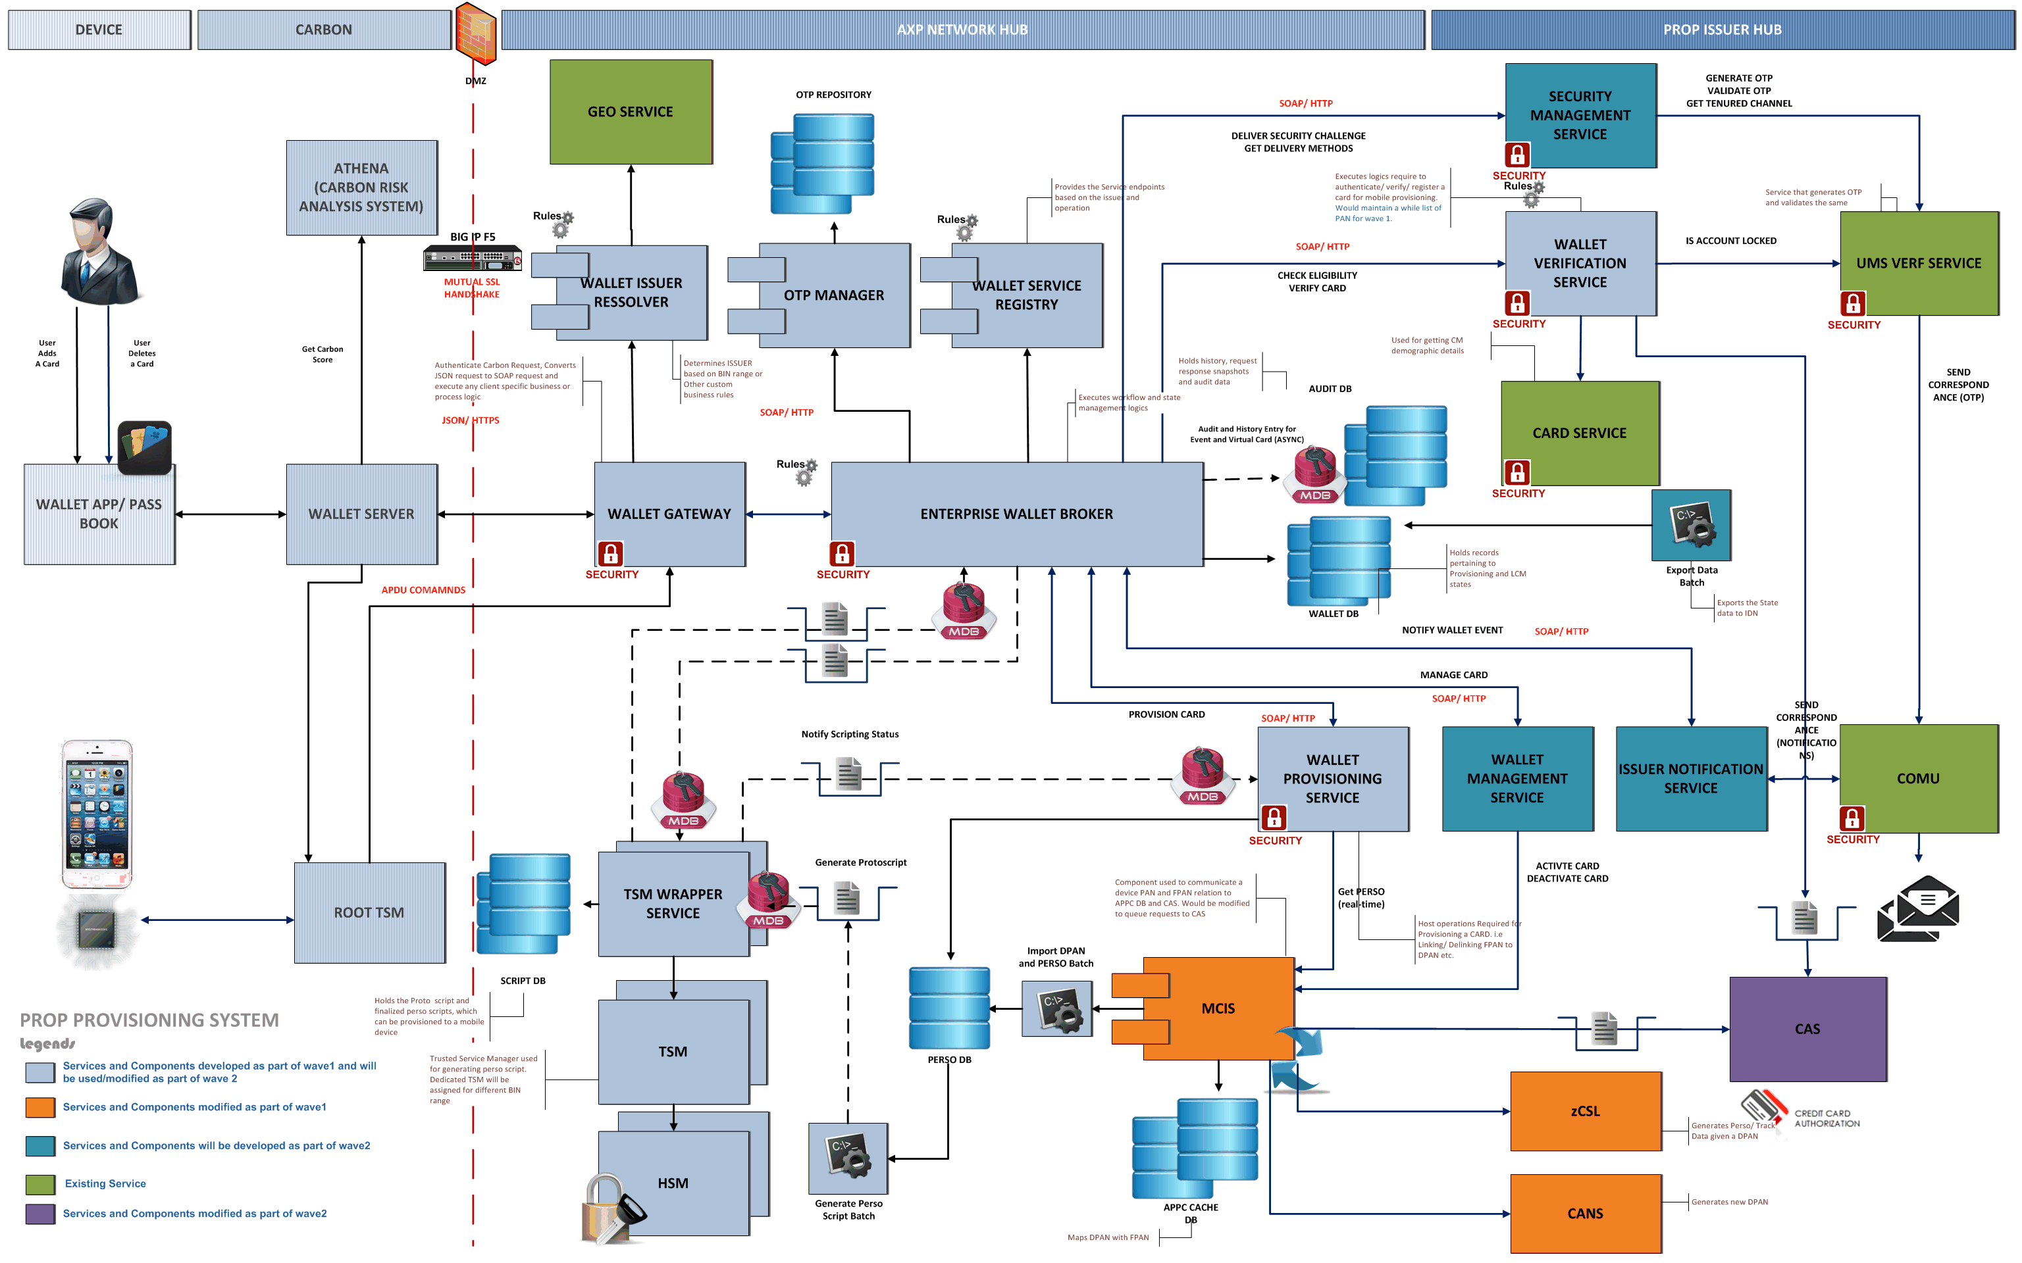
SCARY !!!

Slide 5
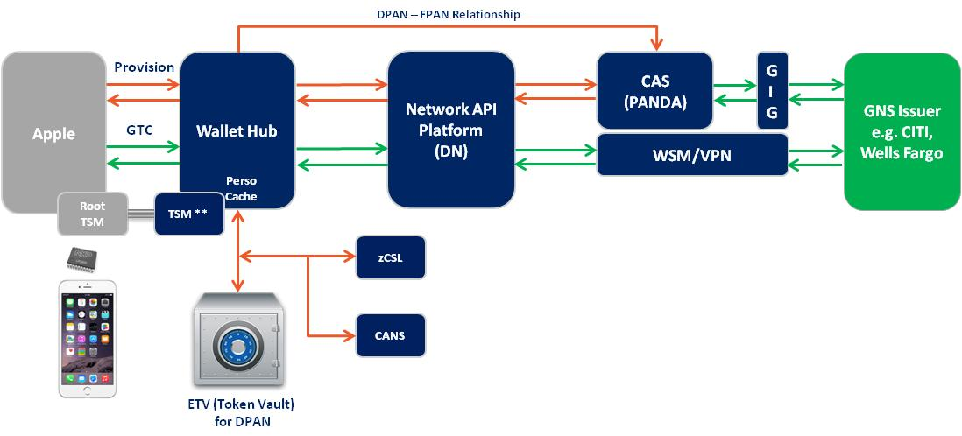
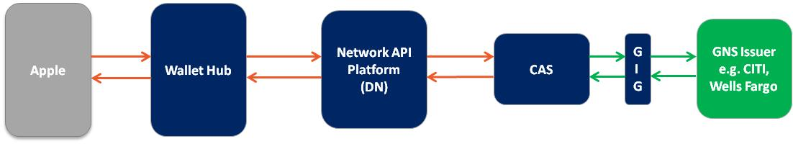
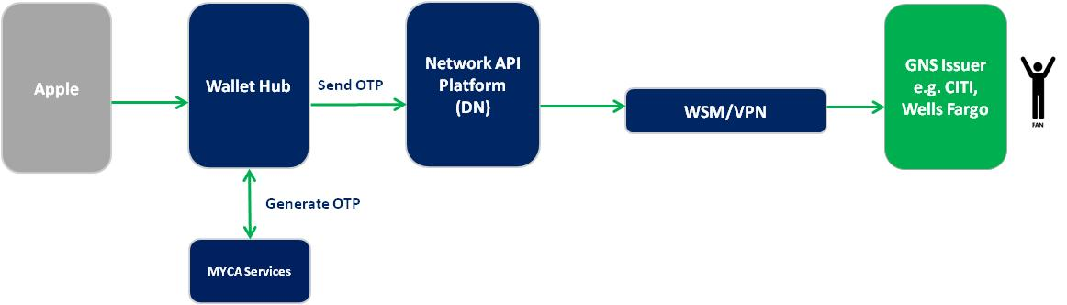
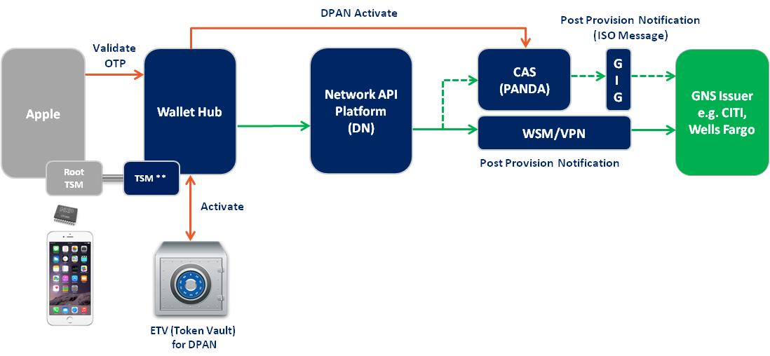
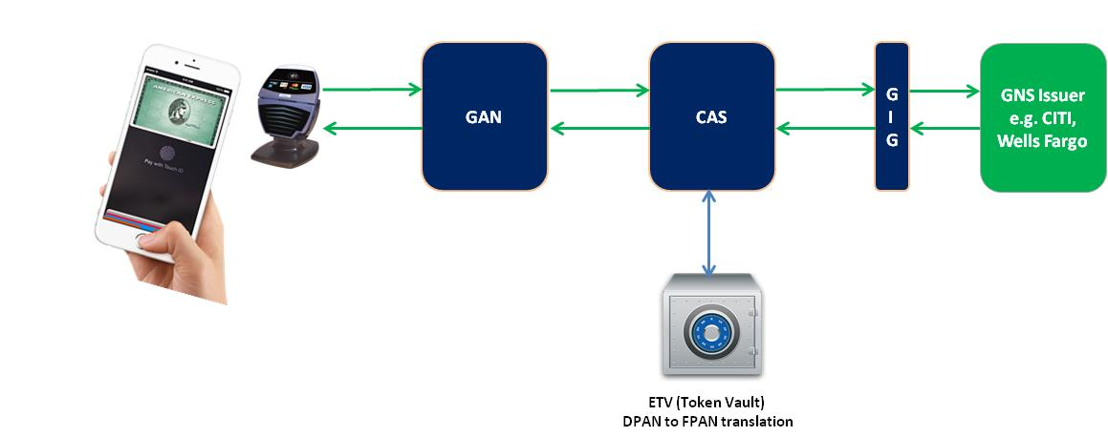
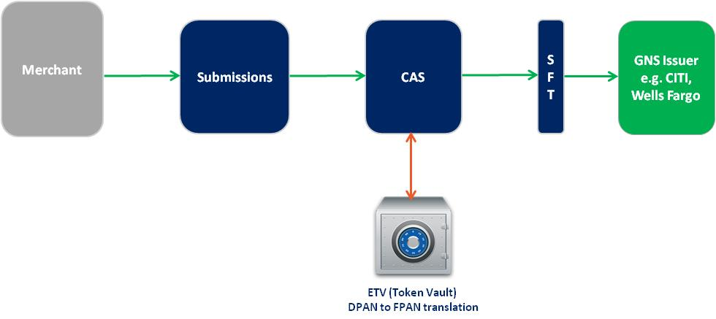
by capability
Add Card
Provision & Tenured Channel
OTP
Activate
NFC Authorization
Settlement

Slide 6
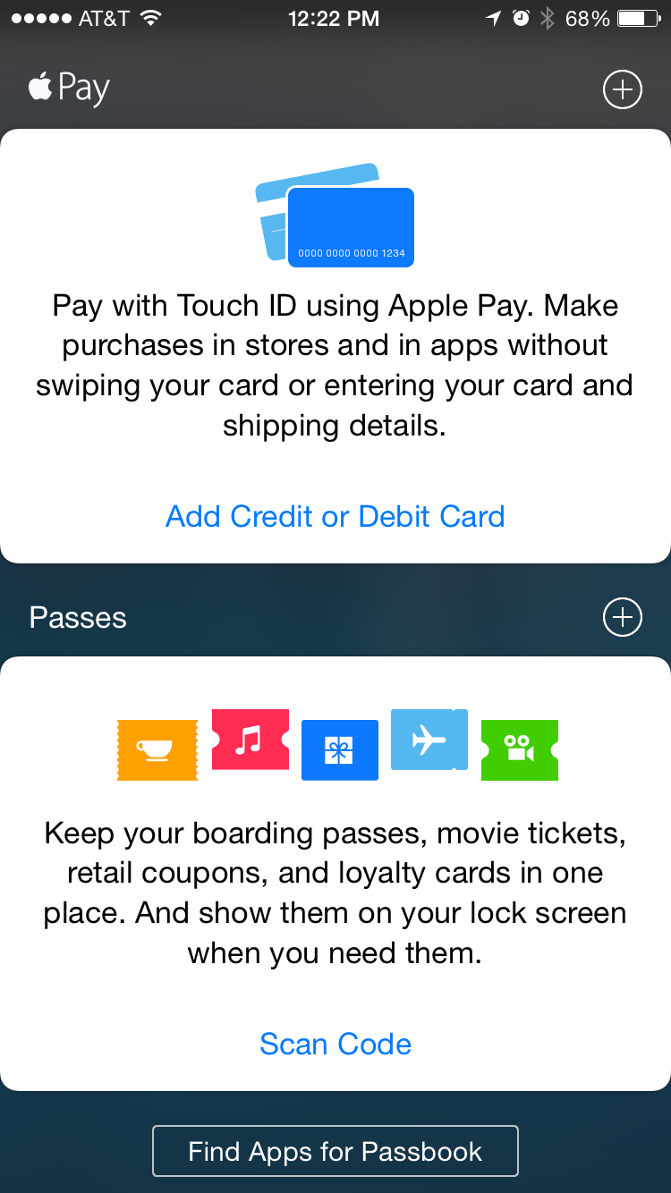
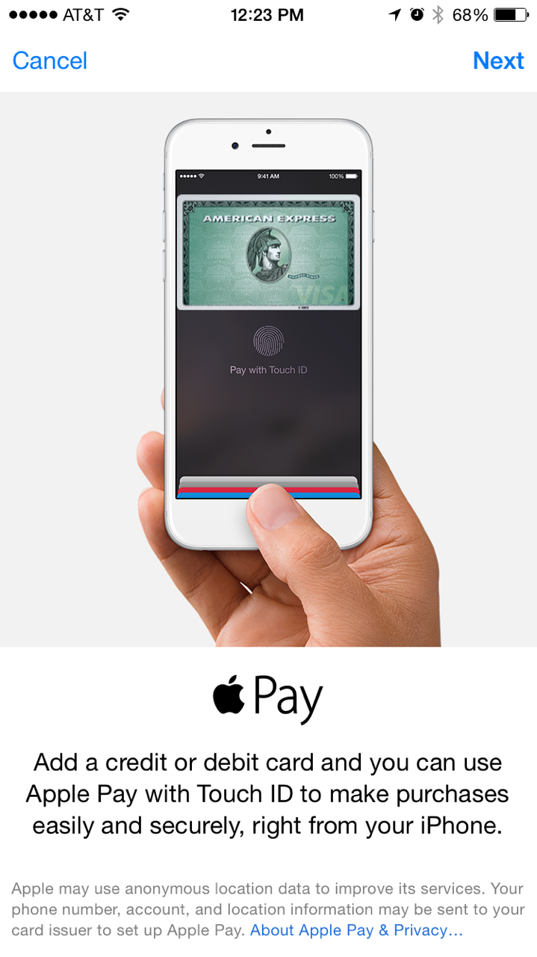

Add card – uX
1
2

Slide 7
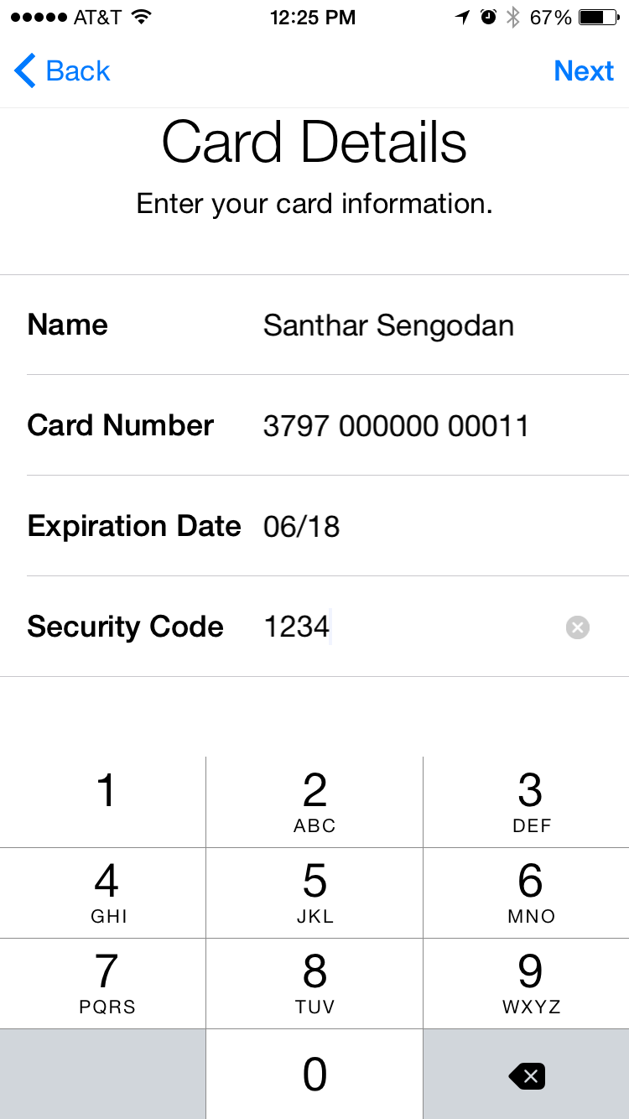
Add card – uX
3
Check Card Request

Slide 8
Add card – behind the scenes
On Network Flow
GNS Issuer Flow
Apple
Wallet Hub
Network API Platform
(DN)
GNS Issuer
e.g. Wells Fargo
CAS
GIG
Issuer eligibility
check
BIN eligibility
Check
&
Orchestration for On Network
Vs. GNS Issuer
CAS NEG file check
1$ auth for eligibility check
(OR)
1100 ISO Message to GNS Issuers

Slide 9
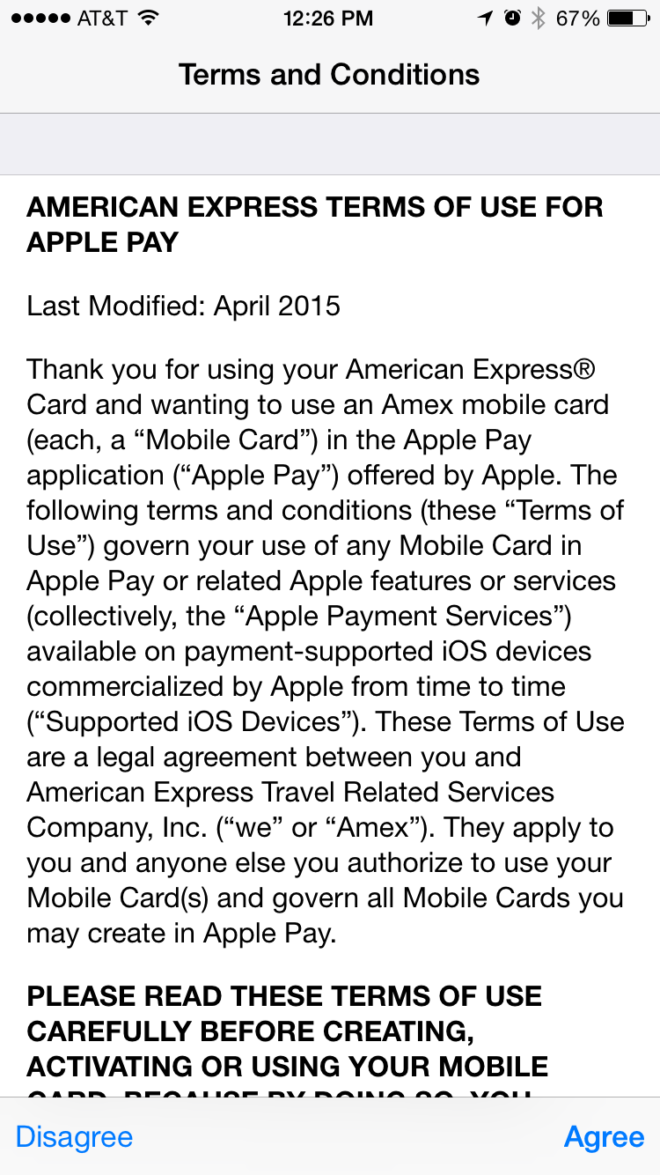
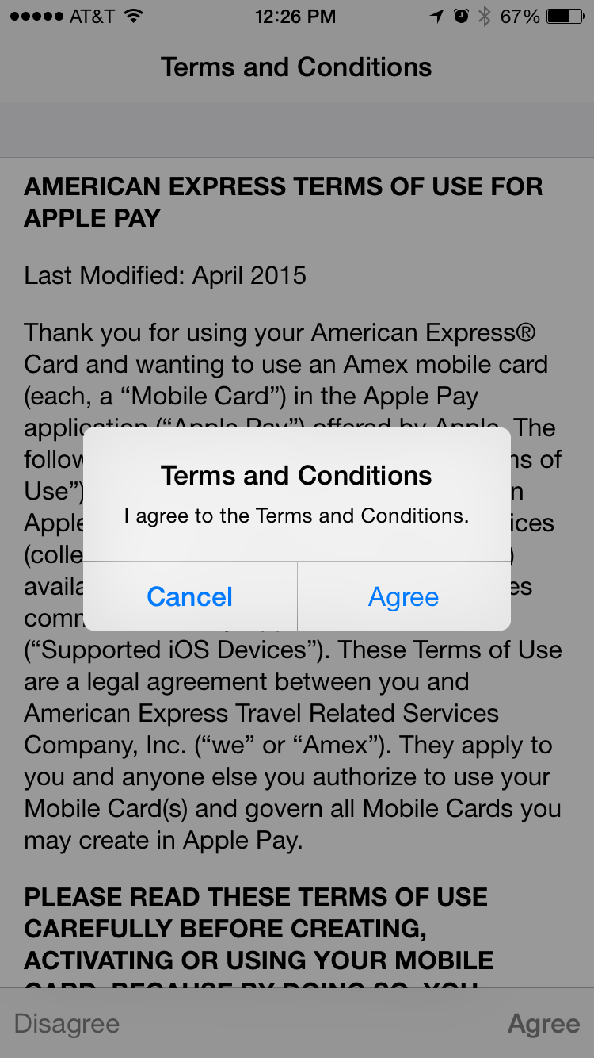
provision – uX
4
5
Check Card Response

Slide 10
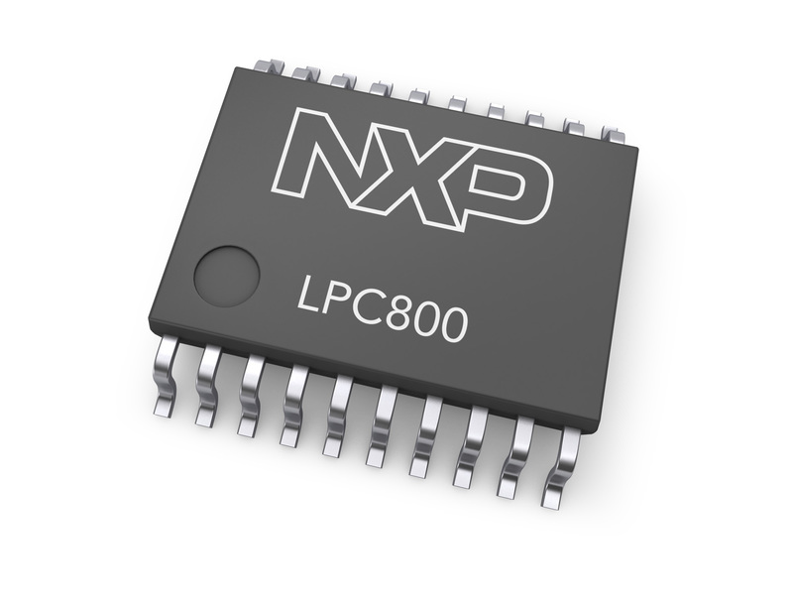
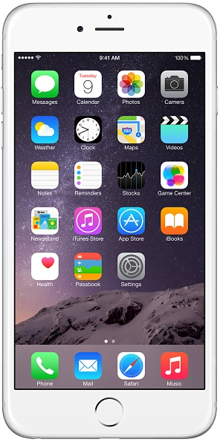

Provision – behind the scenes
Provision Decision
Green
Yellow
Red
On Network Flow
GNS Issuer Flow
CAS PANDA Rules
(OR)
1100 (Pseudo Auth) ISO Message to GNS Issuers
Provision (Risk Parameters)
DPAN – FPAN Relationship
Apple
Wallet Hub
Network API Platform
(DN)
CAS
(PANDA)
GIG
GNS Issuer
e.g. CITI, Wells Fargo
GTC
WSM/VPN
Perso
Cache
Root TSM
TSM **
Orchestration for On Network
Vs. GNS Issuer
Secure Element
zCSL
CANS & ECS
ETV (Token Vault)
for DPAN
Notes:
** TSM (trusted service manager) is a role in a near field communication ecosystem. It acts as a neutral broker that sets up business agreements and technical connections with mobile network operators, phone manufacturers or other entities controlling the secure element on mobile phones.

Slide 11
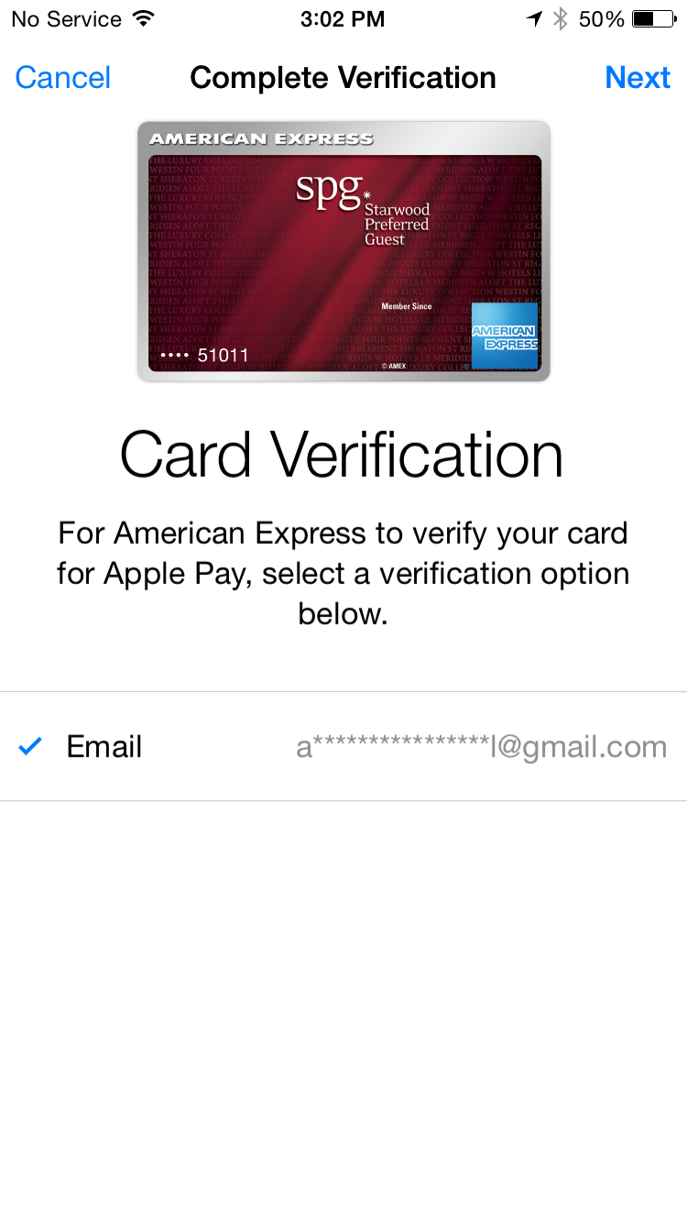
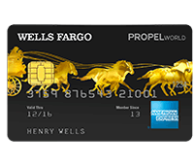
Tenured channel – uX
6
Tenured Channel

Slide 12

OTP – behind the scenes
GNS Issuer Flow
Apple
Wallet Hub
Network API Platform
(DN)
GNS Issuer
e.g. CITI, Wells Fargo
Send OTP
WSM/VPN
Generate OTP
MYCA Services

Slide 13
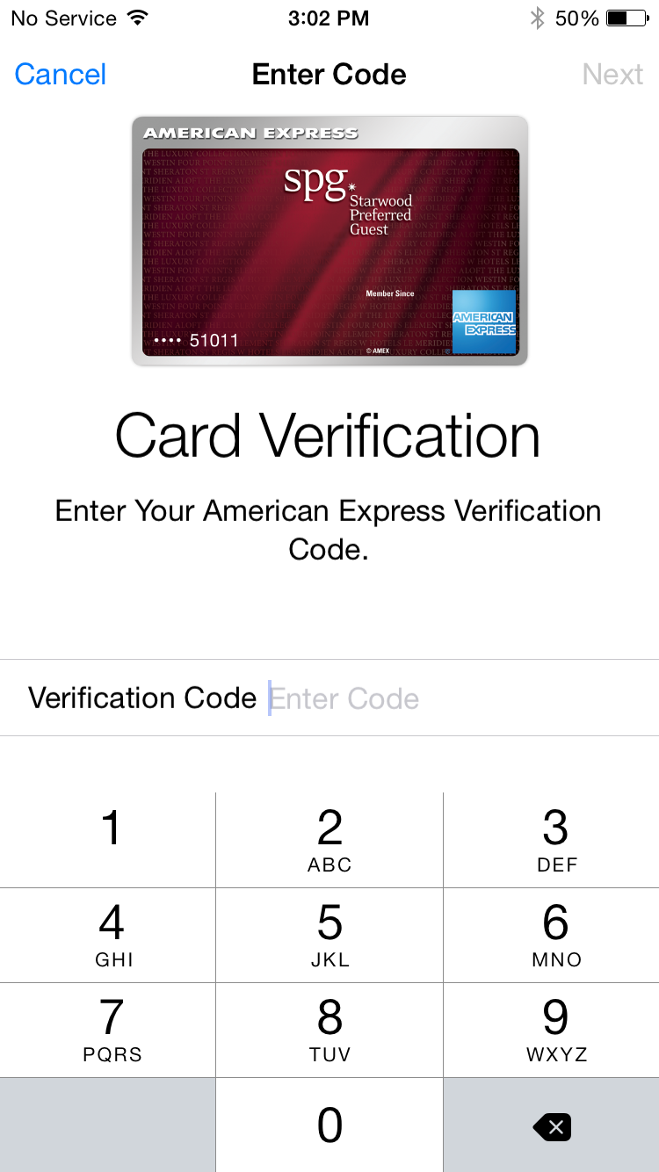
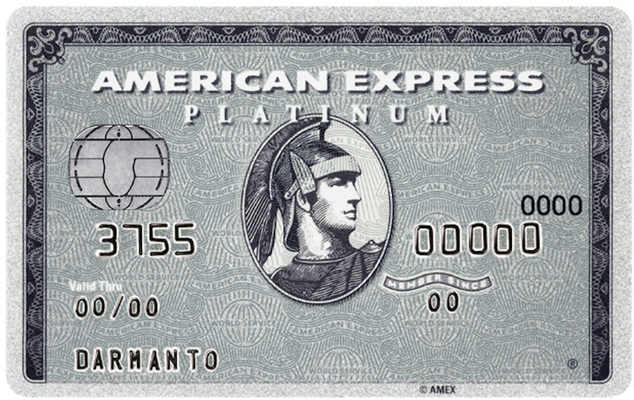
OTP – uX
8
Enter Security Code

Slide 14
activate – behind the scenes
On Network Flow
GNS Issuer Flow
DPAN Activate
Post Provision Notification
(ISO Message)
Validate
OTP
Network API Platform
(DN)
Apple
Wallet Hub
CAS
(PANDA)
GIG
GNS Issuer
e.g. CITI, Wells Fargo
WSM/VPN
Root TSM
TSM **
Post Provision Notification
Activate
ETV (Token Vault)
for DPAN

Slide 15
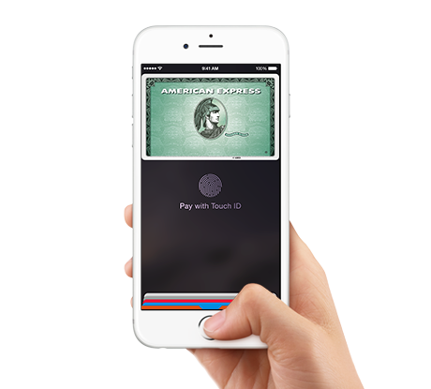
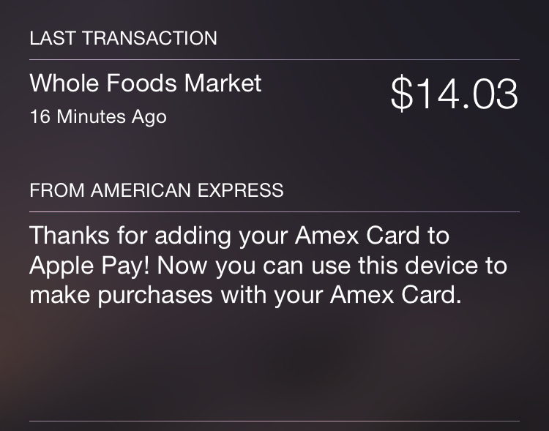
Link & provision – uX
Ready for
Apple Pay

Slide 16
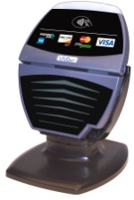
Apple pay : nfc authorization
Login Credentials
Select the Card
Tap to Pay
GAN
CAS
GIG
GNS Issuer
e.g. CITI, Wells Fargo
ETV (Token Vault)
DPAN to FPAN translation

Slide 17
Apple pay : Settlement
Merchant
Submissions
GC&S
SFT
GNS Issuer
e.g. CITI, Wells Fargo
ETV (Token Vault)
DPAN to FPAN translation

Slide 18


Slide 19
Appendix

Slide 20






Mobile nfc: how it works?
Personal Credentials
NFC Chip & Antenna (‘Secure Element’) for data storage
Mobile Wallet App & Widget
Provision cards to Secure Element
Issuer Servicing widget
NFC enabled Terminal at Merchant
Network & Systems
Connection to systems for issuance authorization and settlement of payments
Expresspay Applet

Slide 21
architecture

